Slide 1
COEN 275 Object-Oriented Analysis, Design and Programming
E-COMMERCE PLATFORM
FULL STACK WEB APPLICATION DEVELOPMENT
Project Members:
Snehal Nikam- W1650226
Saurabh Deshmukh- W1648445
Shreya Krishnamoorthy- W1651153
Under the guidance of:
Prof. Paddu Melanahalli
School of Engineering/Graduate Engineering

Slide 2
E-commerce platform - Design
Problem Definition: Design an e-commerce platform using object-oriented programming principles. This application should be able to perform various business functions that occur in online shopping such as user login, products display, shopping cart, order placement and Admin/Seller portal.

Slide 3
Tech Stack
Java (Backend)
Frameworks used: Spring Boot
JavaScript (Frontend)
Frameworks used: Vue.js
MySQL (Database)
Stripe (Integration for Payment portal)

Slide 4
E-commerce platform - Design
Requirement Analysis
Functional Requirements: Admin/Seller portel to add categories and products API to manage categories API to manage products User login and customized profile User interface for customers where products are displayed Features- Shopping cart and Wish list Checkout and payment Order placement and order history Admin/Seller portal to view ordered items and update order status | Non-functional requirements: User friendly interface
Integration requirements: Database for Product Inventory- MySQL Database for User Account information- MySQL Payment gateway- Stripe | Future development requirements: Ease of modification Ease of extension (Adding new features, integrations and functionalities)

Slide 5
Assumptions
The following assumptions are made based on the scope of this project:
The e-commerce store has categories- Electronics, Clothing, Home appliances, Food and Travel
All items fall under exactly one category.
Additional categories are added by the admin/seller whenever new categories and products arise.
Due to its simple relational structure, MySQL is the best database for this project.
The user always prefers Online payment as the mode of payment.
There is no limit for maximum or minimum number of orders as far as the items are in-stock.
All items and categories come under the common distribution site, not under different sellers. There is only one seller.
The admin/seller is able to status of the order delivery and update the same through the portal.
The user never makes an advance payment.
The users never place a return order.

Slide 6
Use cases
Here are the main Actors in our system:
Admin/Seller: Responsible for adding categories and products in the inventory, keeping track of the user orders and updating the delivery status.
Registered Customer: All customers login, select the items, add to wish list, add to shopping cart, checkout and pay for the products.
Guest: Guest are those customers who have not registered yet. They will be able to browse the products or register an account. However, they cannot add products to the cart or place the order unless they login as a registered customer.
Here are the top use cases for the e-commerce store:
Add/Remove/Edit categories and products: Admin/Seller can add, remove or modify a category or a product in a category and related product information.
View Customer Orders: Admin/Seller can view the orders placed by the customers.
Update order status: Admin/Seller can update the order status based on the status of the order delivery.
Browse: Customers can browse through the different categories to select the product.
Add to Wish list: Customers can add a selected item into the wish list.
Add to Shopping cart: Customers can add a selected item into the shopping cart.
Checkout: Customers can checkout the items in the cart for payment
Order payment: Customers will pay for the order
View order history: Customer can view the ordered items.

Slide 7
Classes
Controller classes
CartController
CategoryController
ProductController
UserController
WishListController
Model classes
Cart
Category
Product
User
WishList
Service classes
AuthenticationService
CartService
CategoryService
ProductService
UserService
WishListService

Slide 8
Classes
Repo classes
CartRepository
CategoryRepository
ProductRepository
TokenRepository
UserRepository
WishListRepository
AddressRepository
Wrapper classes
AddToCartWrapper
CartItemWrapper
CartWrapper
ProductWrapper
SignInResponseWrapper
SignInWrapper
SignupWrapper

Slide 9
Classes
Here are the main classes of our e-commerce system:
EcommerceApplication: This is the starter class for this application, with the main() function.
Category: The category has the values- Category ID, Category name, Description, Image URL and the set of products objects under the category.
Product: Each product has a Product ID, Product name, Description, Price, Image URL, isActive status and no. of units in stock.
User: Each user has the values- id, firstName, lastName, email and password.
Cart: Each cart object has the details- id, createdDate, product, user and quantity.
WishList: The wishlist has the values- id, user, createdDate and product.

Slide 10
Classes
CategoryService: This class contains the functions that enable the admin to create, list, get category by name or ID and update category.
ProductService: This class contains the functions that enable the admin to create, list, get the product by ID and update product.
UserService: This class contains the functions which hash the user password and enable the user to sign up/sign in.
CartService: This class contains the functions that enable the user to add items to cart, delete items from cart and view the cart.
WishListService: This class contains the functions that enable the users to create and get the wishlist.
AuthenticationService: This class contains the functions related with authentication such as getting the token, getting the user, saving the confirmation token and authenticating.

Slide 11
Classes
The main classes of our e-commerce system are as follows:
EcommerceApplication: This is the starter class for this application, with the main() function.
EcommerceApplication
main()

Slide 12
Classes
Category: The category has the values- Category ID, Category name, Description, Image URL and the set of products objects under the category.
Category
id
categoryName
description
imgURL
products (set of products)
getId()
getCategoryName()
getDescription()
getImgURL()
getProducts()
setId()
setCategoryName()
setDescription()
setImgURL()
setProducts()

Slide 13
Classes
Product: Each product has a Product ID, Product name, Description, Price, Image URL, isActive status and no. of units in stock.
Product
id
productName
description
imgURL
price
active
unitsInStock
getId()
getProductName()
getDescription()
getImgURL()
getPrice()
getActive()
getUnitsInStock()
setId()
setProductName()
setDescription()
setImgURL()
setPrice()
setActive()
setUnitsInStock()

Slide 14
Classes
User: Each user has the values- id, firstName, lastName, email and password.
User
id
firstName
lastName
Email
phone
password
setId()
setFirstName()
setLastName()
setEmail()
setPassword()
setPhone()
getId()
getFirstName()
getLastName()
getEmail()
getPassword()
getPhone()

Slide 15
Classes
Cart: Each cart object has the details- id, createdDate, product, user and quantity.
Cart
id
createdDate
product
user
quantity
getId()
getCreatedDate()
getProduct()
getUser()
getQuantity()
setId()
setCreatedDate()
setProduct()
setUser()
setQuantity()

Slide 16
Classes
WishList: The wishlist has the values- id, user, createdDate and product.
WishList
id
user
createdDate
product
getId()
getUser()
getCreatedDate()
getProduct()
setId()
setUser()
setCreatedDate()
setProduct()

Slide 17
Classes
CategoryService: This class contains the functions that enable the admin to create, list, get category by name or ID and update category.
CategoryService
categoryRepo
create()
getAllCategories()
getCategory()
update()

Slide 18
Classes
ProductService: This class contains the functions that enable the admin to create, list, get the product by ID and update product.
ProductService (Decorator Pattern)
productRepo
create()
getProductFromWrapper()
getProduct()
getAllProducts()
createProductWrapper()
update()

Slide 19
Classes
AuthenticationService: This class contains the functions related with authentication such as getting the token, getting the user, saving the confirmation token and authenticating.
AuthenticationService
tokenRepository
saveConfirmationToken()
getToken()
getUser()
authenticate()

Slide 20
Classes
UserService: This class contains the functions which hash the user password and enable the user to sign up/sign in.
UserService (Decorator pattern)
userRepository
authenticationService
signUp()
hashPassword()
signIn()

Slide 21
Classes
CartService: This class contains the functions that enable the user to add items to cart, delete items from cart and view the cart.
CartService (Decorator Pattern)
productService
cartRepository
addToCart()
listCartItems()
deleteCartItems()

Slide 22
Classes
WishListService: This class contains the functions that enable the users to create and get the wishlist.
WishListService (Decorator pattern)
wishListRepository
productService
categoryService
createWishlist()
getWishListForUser()

Slide 23
OO Concepts
MAIN PILLARS
Abstract class & Interfaces
Encapsulation
Inheritance
Polymorphism
Data structure: Lists, ArrayLists
UML DESIGN
Has-a relationship
Is-a relationship

Slide 24
OO Concepts
CLASSES AND CONCEPTS USED IN CODE:
EcommerceApplication
Category => POLYMORPHISM, OVERLOADING, OVERRIDING
Product => POLYMORPHISM, OVERLOADING
User=> POLYMORPHISM, OVERLOADING
Cart=>
Wishlist=> POLYMORPHISM, OVERLOADING
CategoryService => POLYMORPHISM, OVERLOADING, LIST
ProductService=> DECORATOR PATTERN
AuthenticationService=> EXCEPTIONS
UserService=> WRAPPERS, EXCEPTIONS, ARRAYS
CartService=> WRAPPERS, EXCEPTIONS, LIST
WishListService=> WRAPPERS, LIST

Slide 25
OO Concepts
CategoryController=> LIST, EXCEPTIONS
ProductController=> LIST, EXCEPTIONS, WRAPPERS
UserController=> -
CartController=> WRAPPER
WishListController=>LIST
CategoryRepository=> INHERITANCE, INTERFACE, LIST
ProductRepository=> INHERITANCE, INTERFACE, LIST
TokenRepository=> INHERITANCE
UserRepository=> INHERITANCE, INTERFACE
CartRepository=>INHERITANCE, INTERFACE, LIST
WishListRepository=>INHERITANCE, INTERFACE, LIST

Slide 26
UML Use case and diagrams

Slide 27
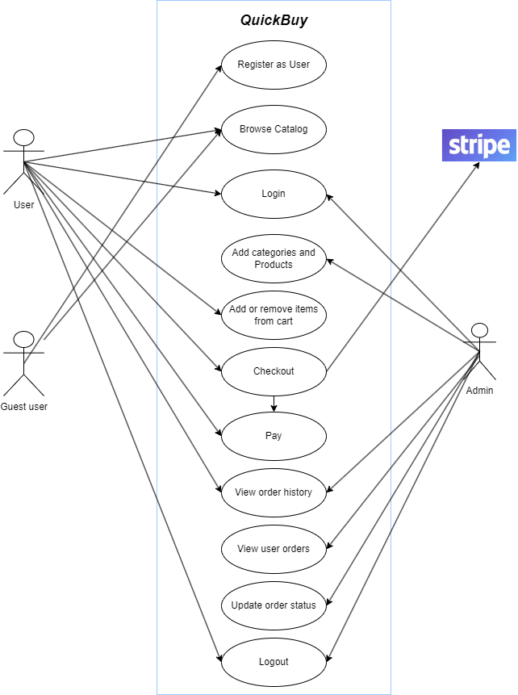
Use case diagram
Notes:
Delete- not there.

Slide 28
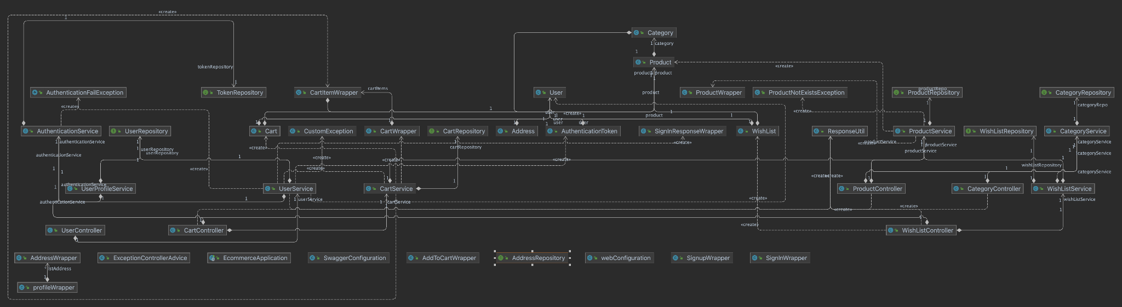
Class Diagram

Slide 29
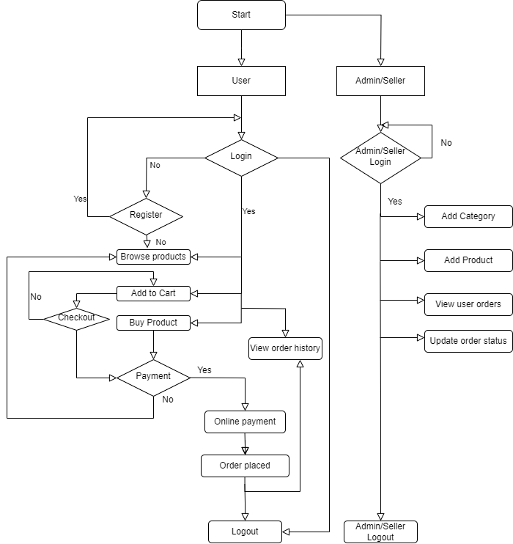
Flowchart

Slide 30
Class Implementation Examples

Slide 31
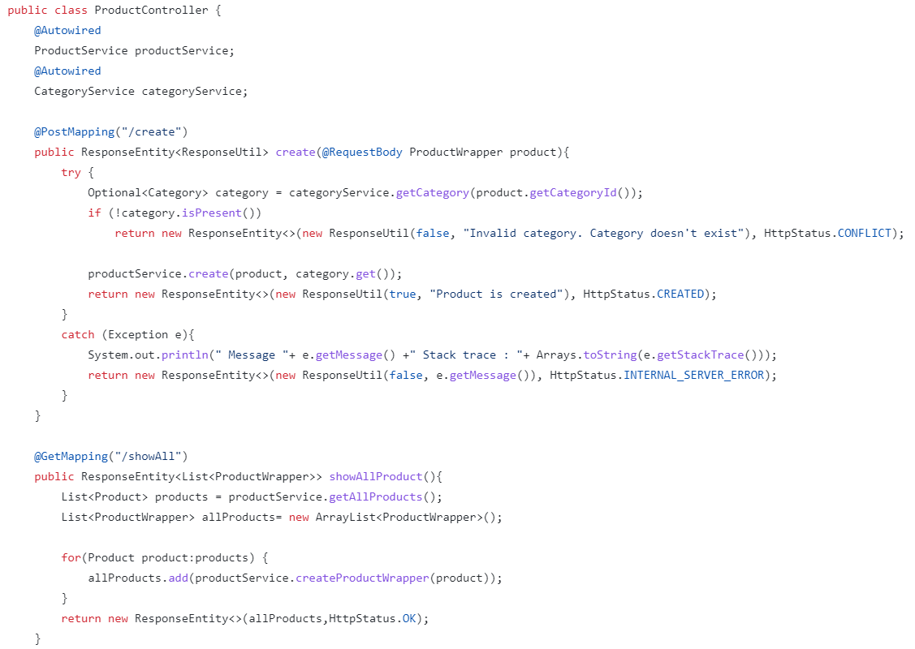
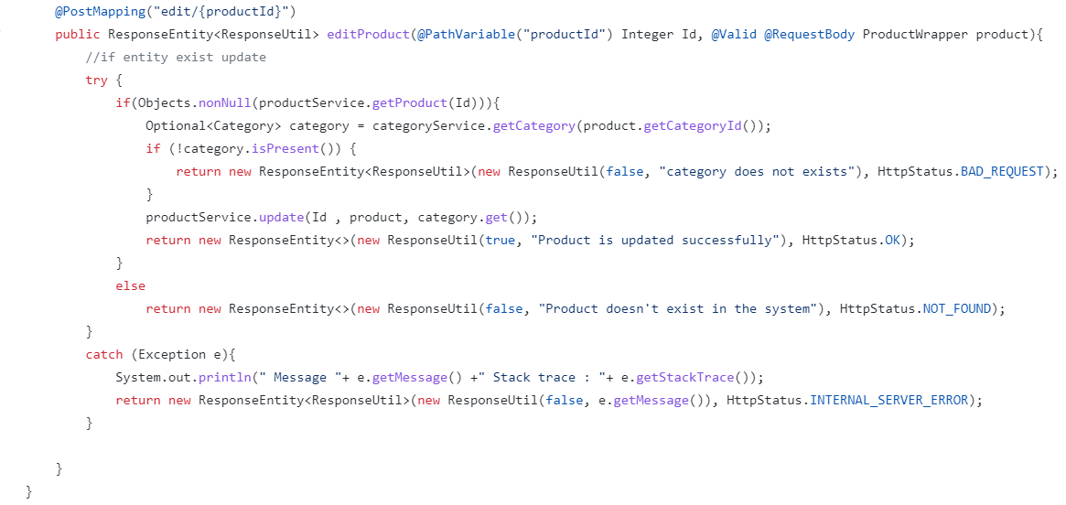
Controller Class Example:

Slide 32
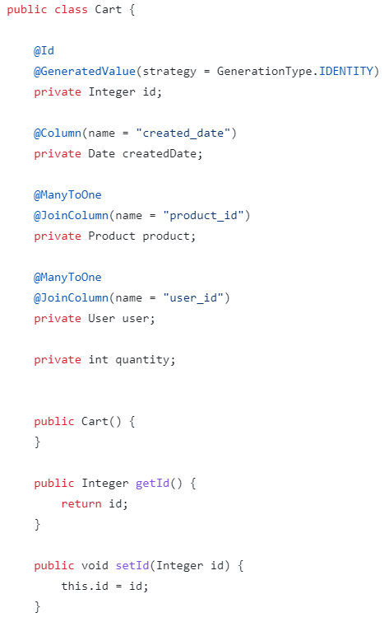
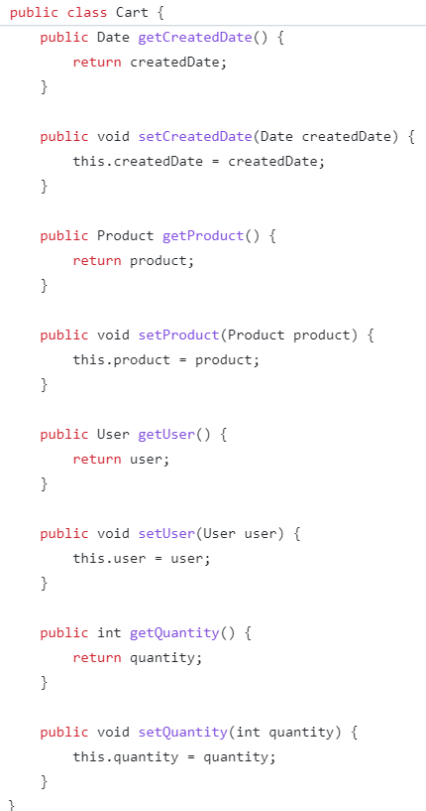
Model Class Example:

Slide 33
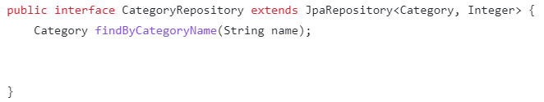
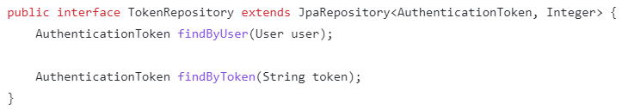
Repo Class Example:

Slide 34
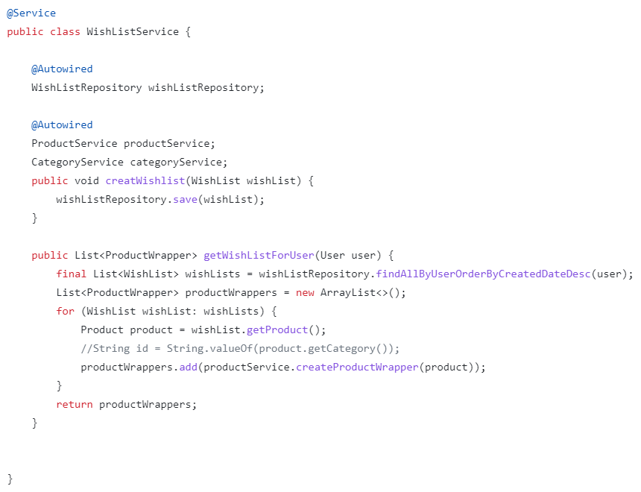
Service Class Example:

Slide 35
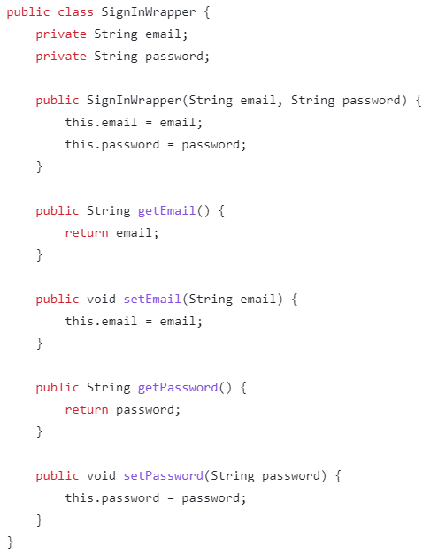
Wrapper Class Example:

Slide 36
Link to Code Repository
https://github.com/Snehal-Nikam/ecommerce.git

Slide 37
Output Screen Shots

Slide 38
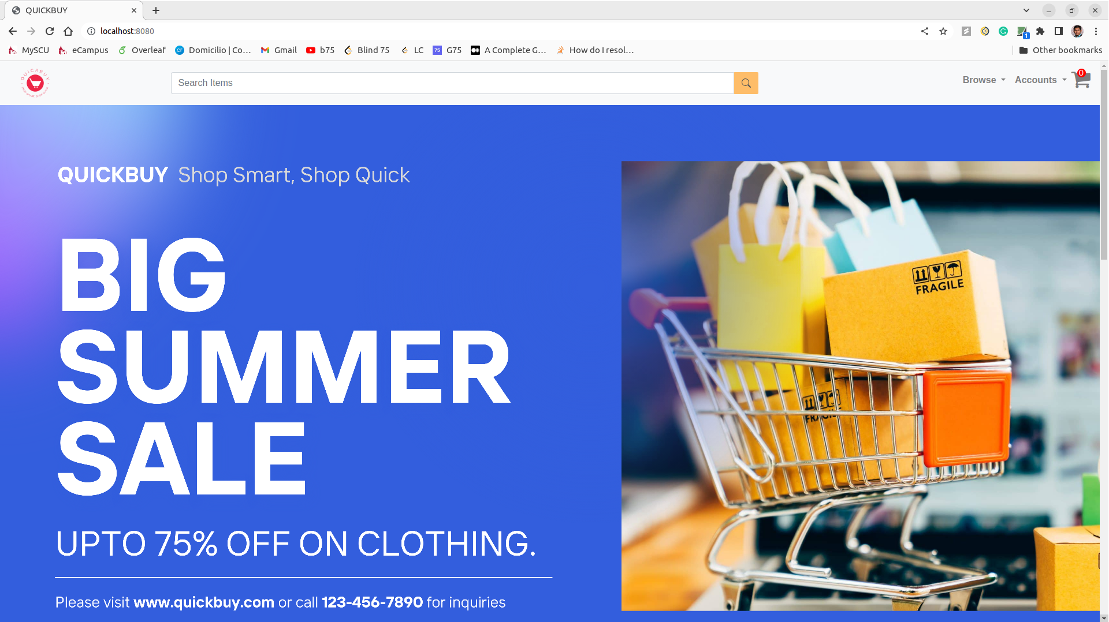

Slide 39
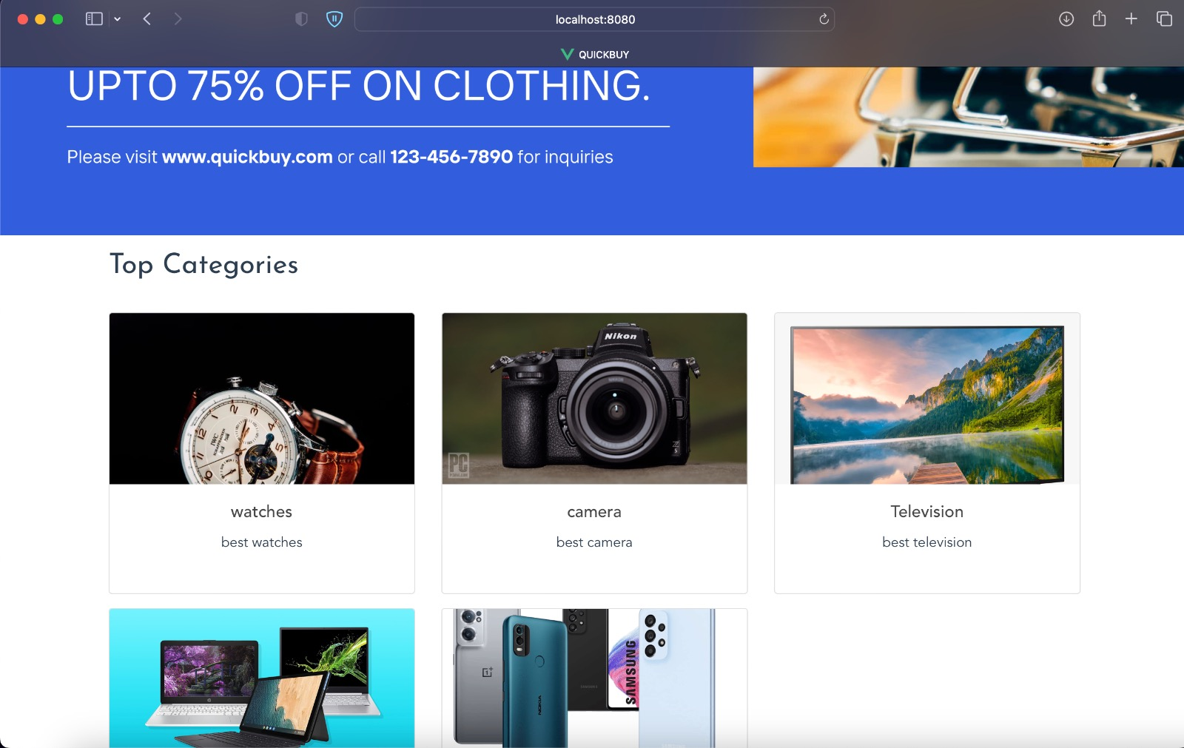

Slide 40
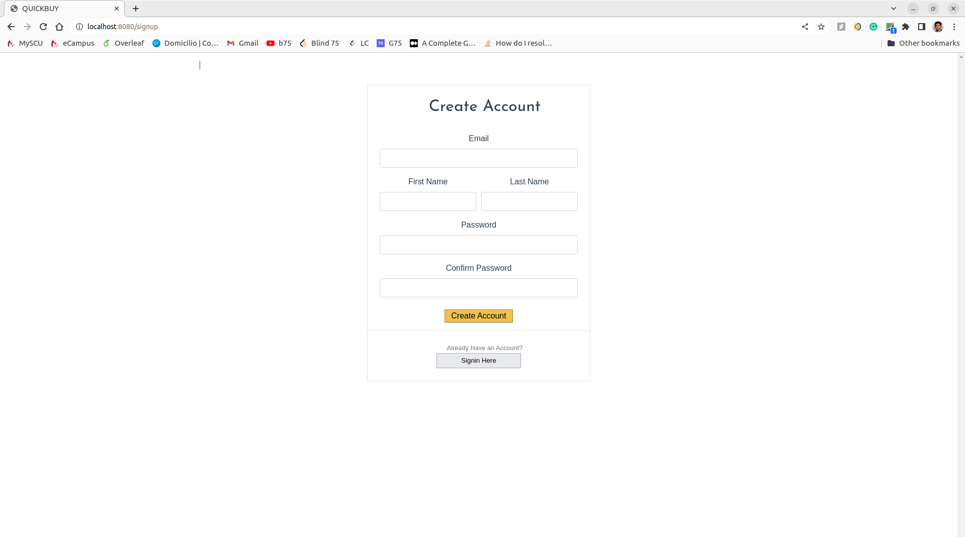
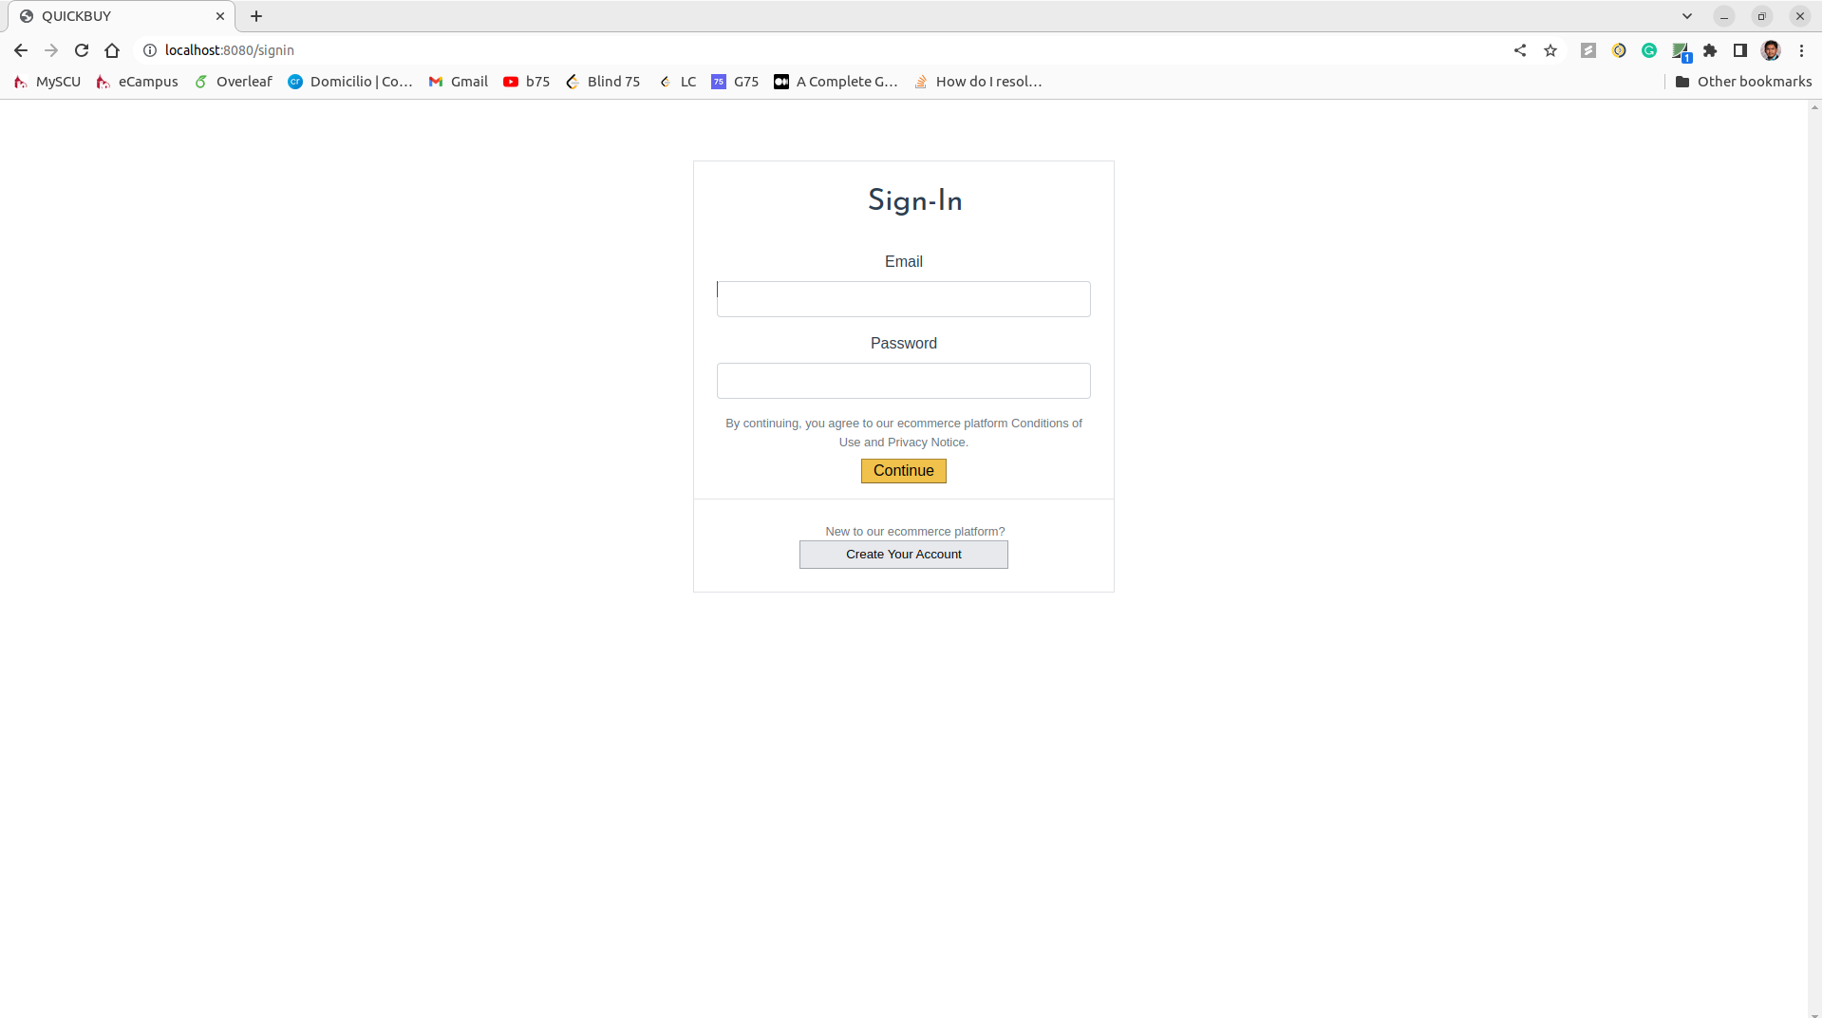

Slide 41
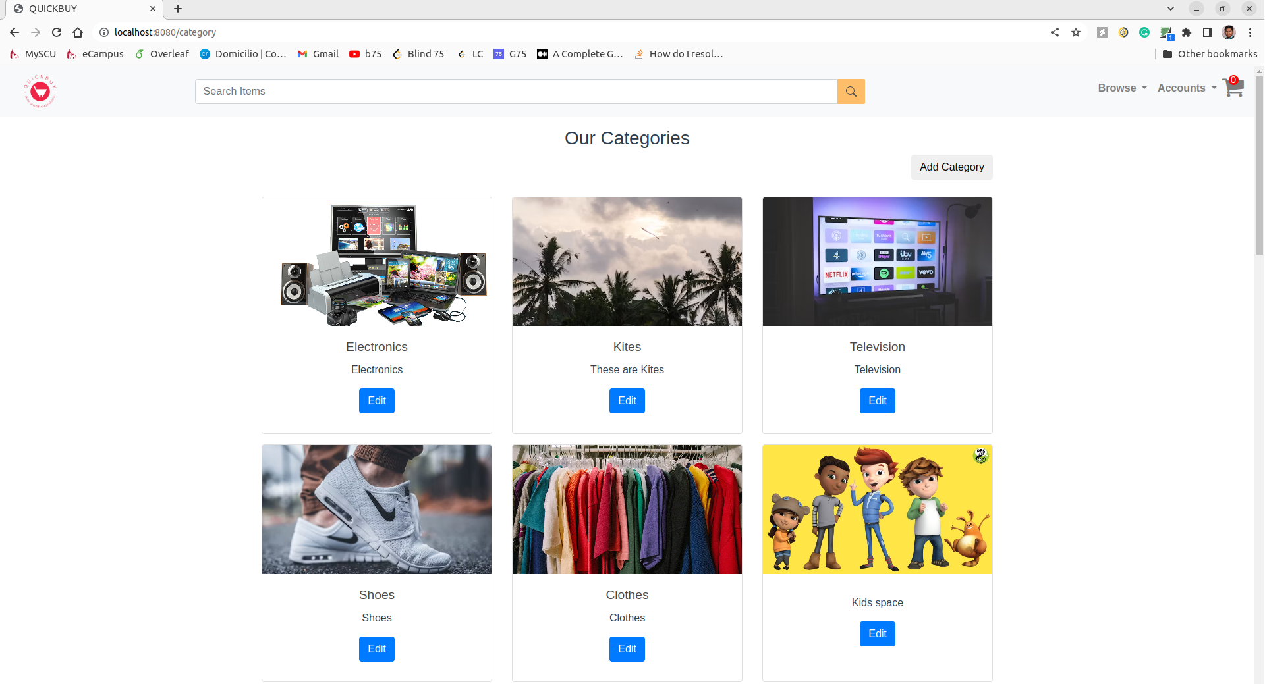

Slide 42
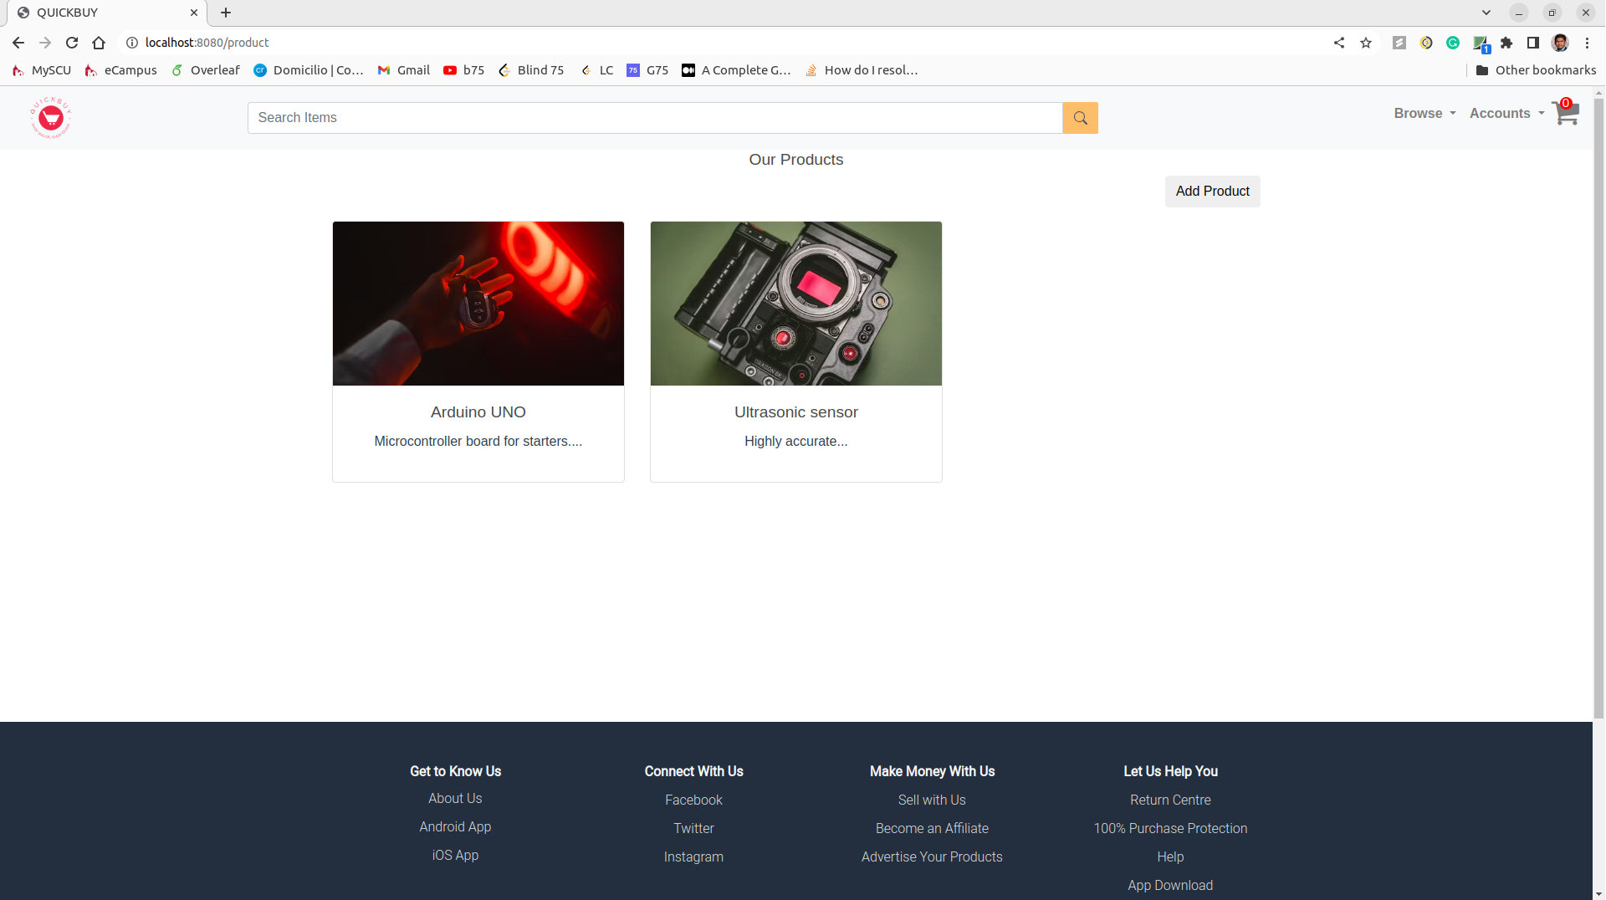

Slide 43
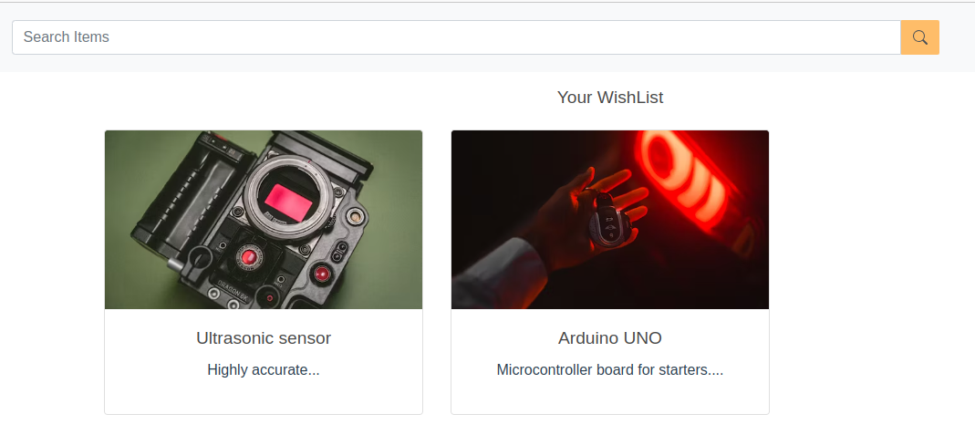

Slide 44
Any questions ?

Slide 45
Thank you

